Slide 1

A PRACTICAL CHECKLIST
THE TYPE 1 & ALLERGY TRAVEL CHECKLIST
Everything I take while travelling with Type 1 diabetes and severe food allergies.
+
INSULIN
⚡
HYPOS
!
ALLERGIES
Notes:
Cover photograph: original photograph supplied by Ollie Steadman.
The original photograph is used untouched; no AI-generated or AI-edited imagery is present.

Slide 2
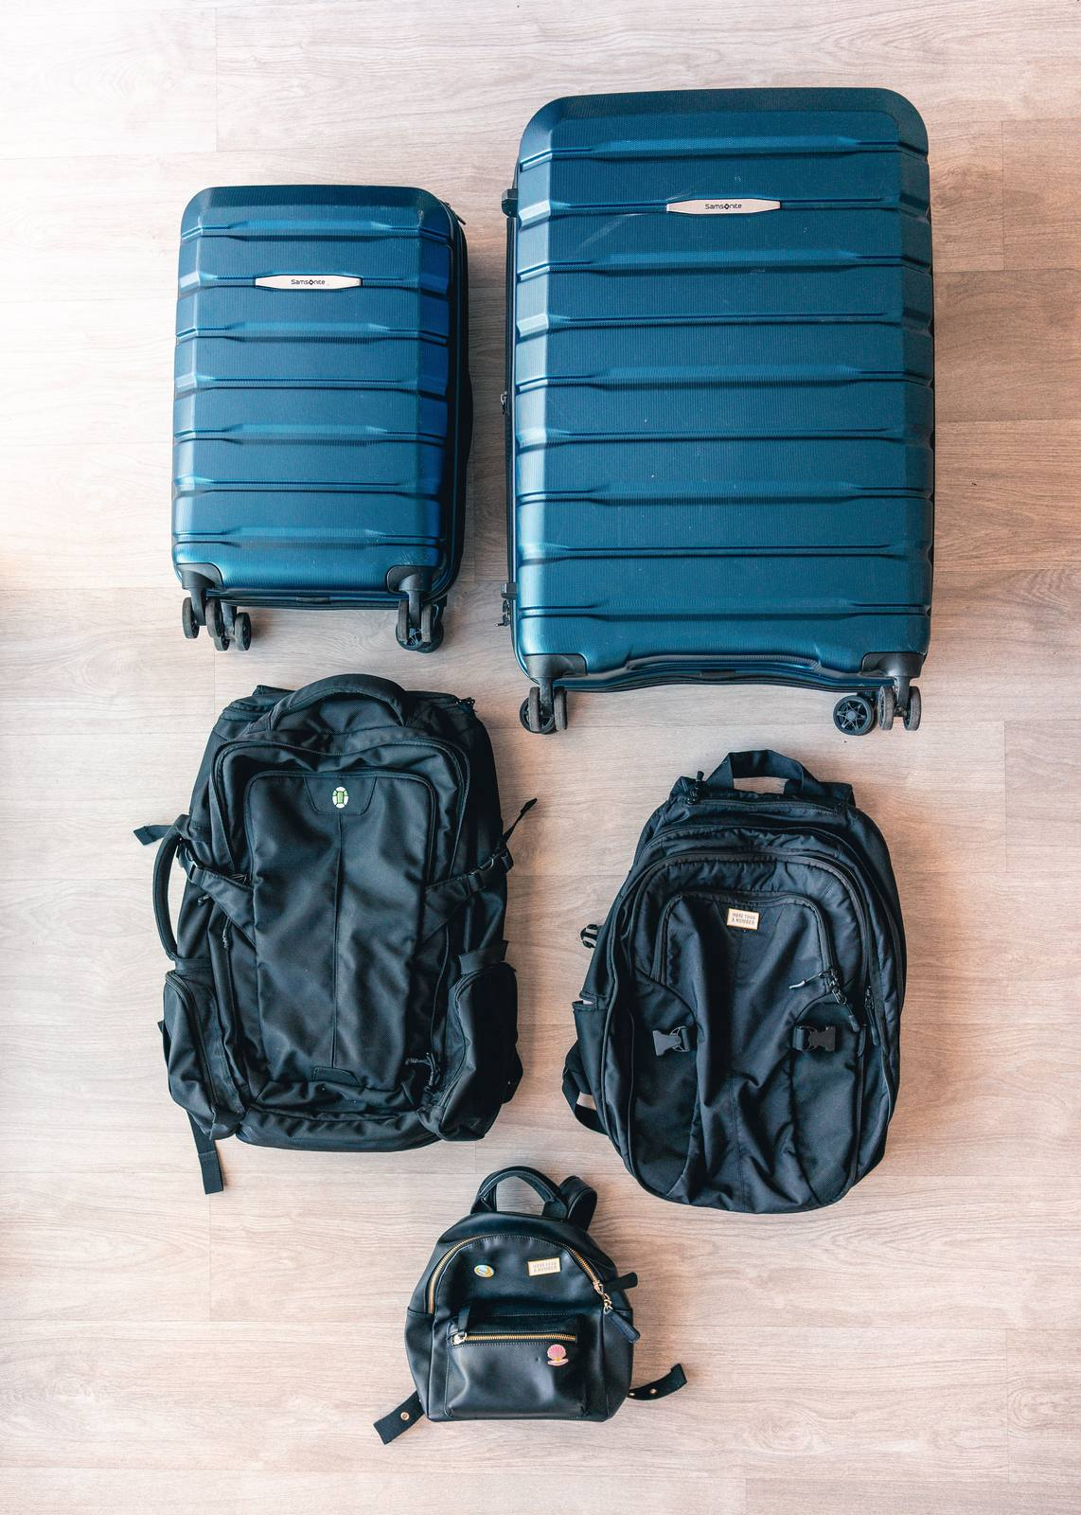
PACKING SYSTEM
02 / 14
Packing Structure
Build the bags so losing one does not leave you without essential treatment.
40–55 L main backpack
20 L day pack
Cabin medical reserve
On-body emergency pouch
Useful tips:
Keep insulin and critical medicines out of hold luggage
Split duplicates between two cabin bags or with a companion
WHY IT WORKS
Main bag: bulk. Day pack: next 24 hours. On-body pouch: immediate hypo treatment and both auto-injectors (EpiPens).
If one bag disappears, you should still be able to manage safely in the short term
THE ULTIMATE TYPE 1 TRAVEL PACKING LIST
2
Notes:
Practical bag-allocation system based on the author’s travel experience and Diabetes UK travel guidance.
Photograph: ThiS HAN via Pexels — https://www.pexels.com/photo/flat-lay-of-luggage-and-bags-4004224/

Slide 3

INSULIN SAFETY
03 / 14
Keep insulin cool, never frozen
Protect it from heat, water and accidental freezing (always double check insulin will not freeze when putting in a fridge and make sure staff know not to move your supplies!
Frio Cooling Wallet Extra Large x 1
Frio Cooling wallet Medium x 1
Frio Cooling wallet Small x 1
Waterproof bags for dry supplies
Remember:
Never place insulin directly against ice or freezer packs
Keep it away from freezer plates and frozen zones
Protect it from heat, direct sunlight and hot vehicles
A LESSON FROM VIETNAM
In a hostel in remote Vietnam, my insulin was accidentally frozen. Cold is not the same as safe: once insulin has frozen, it may no longer work.
Follow the storage instructions for your insulin.
THE ULTIMATE TYPE 1 TRAVEL PACKING LIST
4
Notes:
Sources: NHS insulin storage guidance and Diabetes UK travel guidance.
Photograph and Vietnam story: supplied by Ollie Steadman.

Slide 4


DIABETES KIT
04 / 14
Type 1 Medical Supplies & Glucose
Take every prescribed item plus backups agreed with your diabetes team.
All prescribed insulin
Written insulin names
Extra insulin
Medical ID card or bracelet
Spare insulin pens
Glucagon, if prescribed
Cartridges or vials
Injection set in the day pack
Pen needles
Cabin-bag medical reserve
Syringes, if part of your plan
Original labels/packaging
Travel sharps container
Glucose tablets or gel (Pack as much as you can)
Sealed sweets
MY TIP
Agree the extra quantity with your diabetes team. I divide the reserve so one lost bag cannot remove every backup.
CABIN-BAG RULE: all insulin, medicines and critical supplies stay with you, not in hold luggage.
THE ULTIMATE TYPE 1 TRAVEL PACKING LIST
3
Notes:
Sources: Diabetes UK — Travelling with diabetes: https://www.diabetes.org.uk/living-with-diabetes/life-with-diabetes/travel
NHS — Storing and travelling with insulin: https://www.nhs.uk/medicines/insulin/short-acting-insulin/storing-and-travelling-with-short-acting-insulin/
Photograph: original photograph supplied by Ollie Steadman.

Slide 5
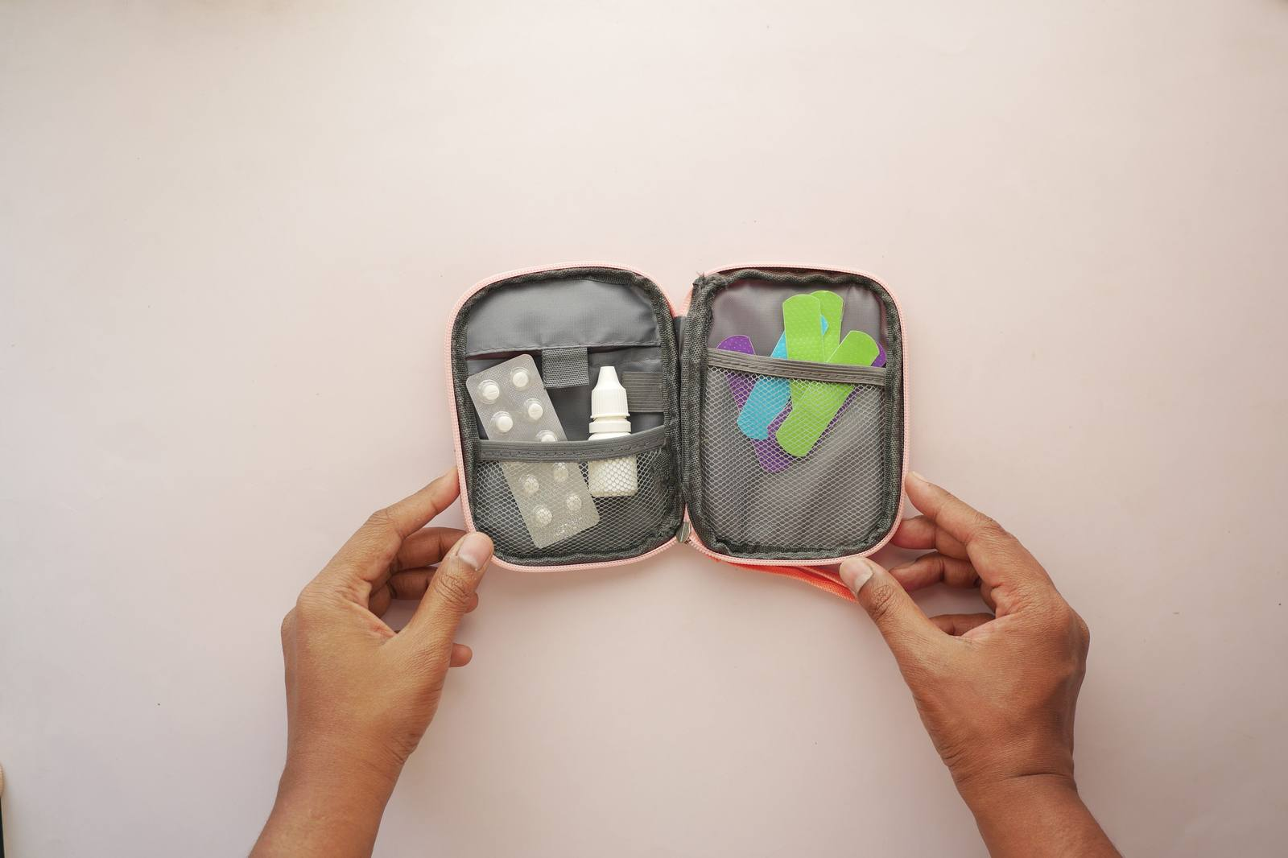
ALLERGY SAFETY
05 / 14
Allergy plan (if applicable)
Carry a complete kit, keep it accessible and make sure someone else can find it.
Two auto-injectors (EpiPens)
Reusable cutlery
Protective auto-injector case
Family phone numbers
Antihistamine, if advised
Insurer’s emergency number
Allergy action plan
Local emergency number
Translated allergy cards
Medical identification card or medic alert bracelet
Written allergen list
Emergency contact card
MY TIP
Both prescribed auto-injectors remain immediately accessible.
SAFETY RULE: antihistamines do not replace adrenaline during anaphylaxis. Follow your action plan and call emergency services.
THE ULTIMATE TYPE 1 TRAVEL PACKING LIST
7
Notes:
Sources: NHS — Anaphylaxis: https://www.nhs.uk/conditions/anaphylaxis/
Resuscitation Council UK — Anaphylaxis FAQs: https://www.resus.org.uk/professional-library/faqs/faqs-anaphylaxis
Photograph: Towfiqu barbhuiya via Pexels — https://www.pexels.com/photo/medicines-and-band-aids-in-a-kit-14624610/

Slide 6
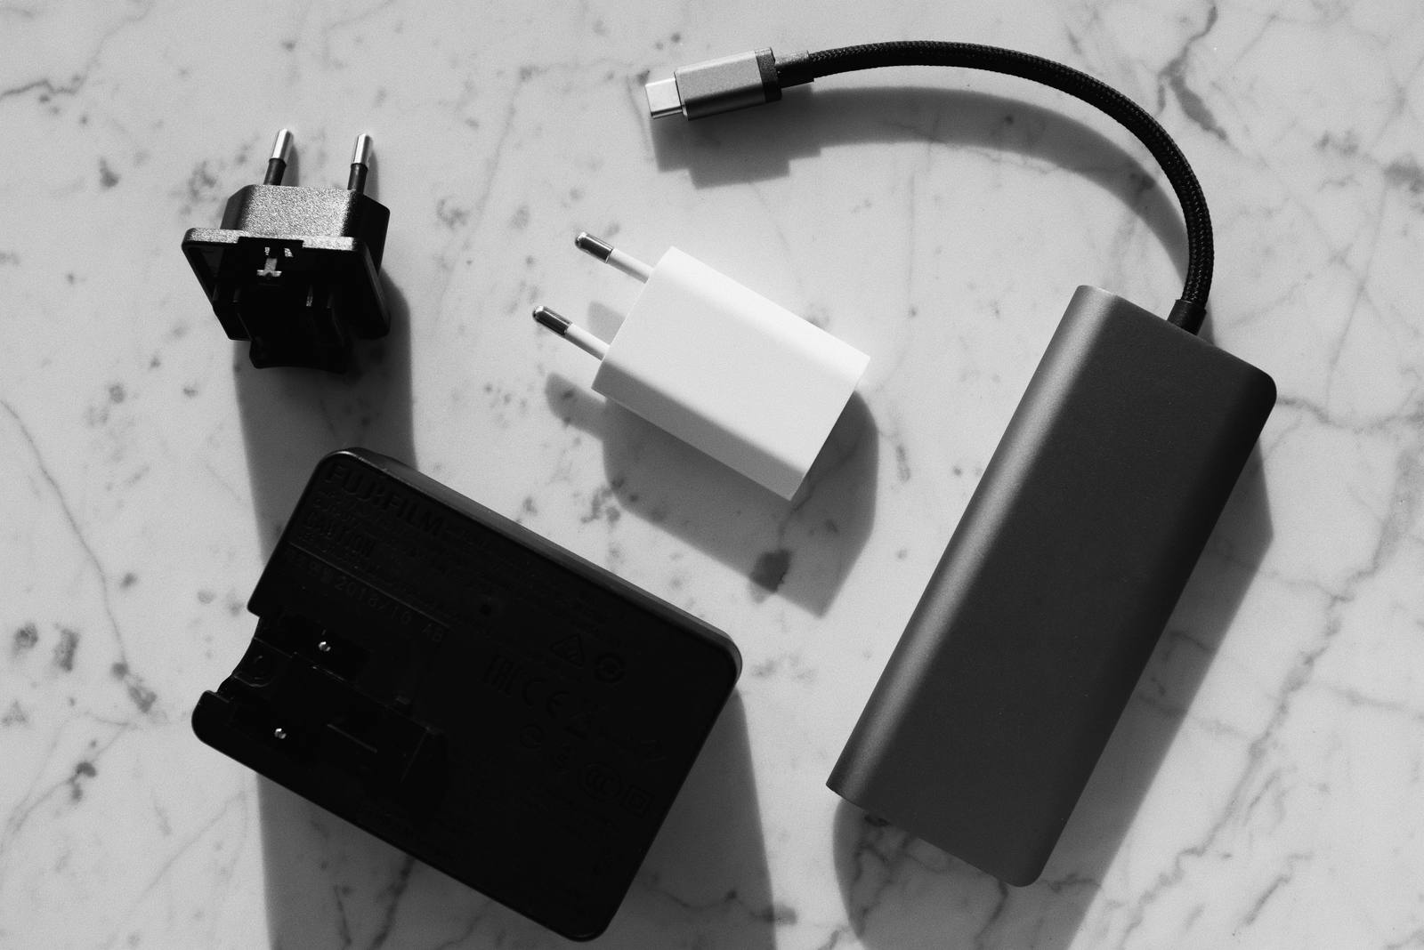
TECH & POWER
06 / 14
Tech Essentials
Make sure you always keep your phones battery high as much as you can. However, aflat battery should not stop you from checking your blood glucose.
Primary phone
eSIM or local SIM
Cheap Backup phone, charged
SIM tool
Spare USB charging plug
Power banks × 2
Torch or head torch
Multi-port USB charger
Waterproof phone pouch
Travel adaptor
Charging cables × 3
Luggage tracker
Cables and plugs tested
MY TIP
Look after your phone, it is most likely very important for monitoring your sugar levels
FLIGHT RULE: power banks stay protected in cabin baggage. Check your airline’s current limits and onboard-use rules.
THE ULTIMATE TYPE 1 TRAVEL PACKING LIST
11
Notes:
Source: UK Civil Aviation Authority — Pack right: https://www.caa.co.uk/packright
Photograph: ready made via Pexels — https://www.pexels.com/photo/photo-of-power-bank-near-socket-3921697/

Slide 7
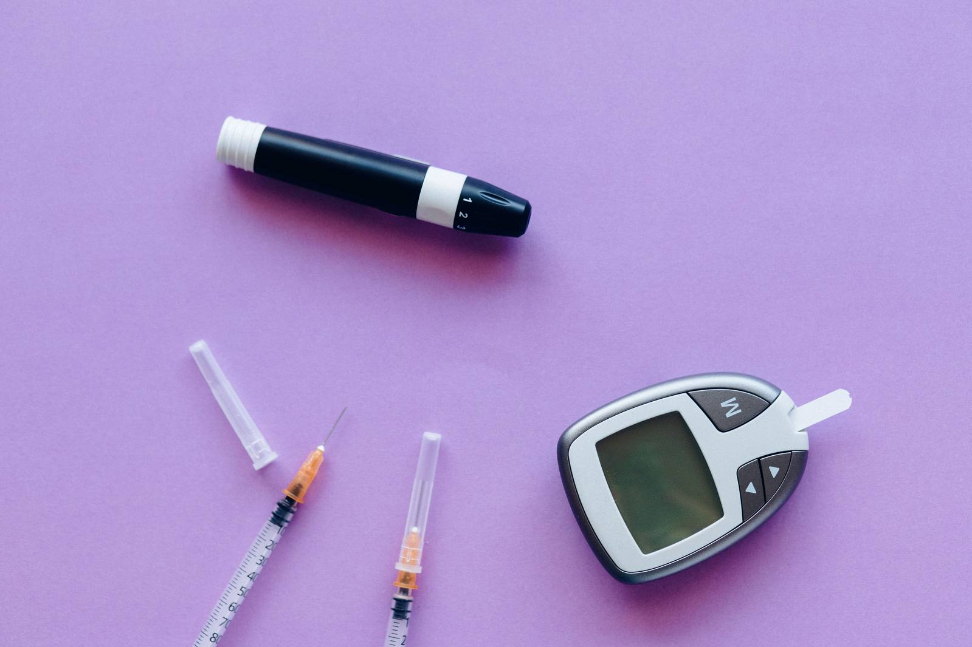
DEVICES & TESTING
07 / 14
Back up every device
Every electronic system needs a tested backup
Pump charger and cable if applicable
CGM sensors
Spare approved batteries
Sensor applicators
Adhesive patches
Transmitter, if separate
Blood glucose monitor x 2
Receiver or reader
Written pump settings
Finger-pricker
Test strips and lancets
Ketone meter and strips
MY TIP
Agree a pump-failure plan with your diabetes team and test the backup meter, charger and injection kit before leaving.
REMOVE SINGLE POINTS OF FAILURE: a flat phone, failed sensor or broken charger must not remove your only option.
THE ULTIMATE TYPE 1 TRAVEL PACKING LIST
5
Notes:
Source: Diabetes UK — Travelling with diabetes: https://www.diabetes.org.uk/living-with-diabetes/life-with-diabetes/travel
Photograph: Nataliya Vaitkevich via Pexels — https://www.pexels.com/photo/diabetic-kit-and-insulin-over-a-purple-surface-6941102/

Slide 8
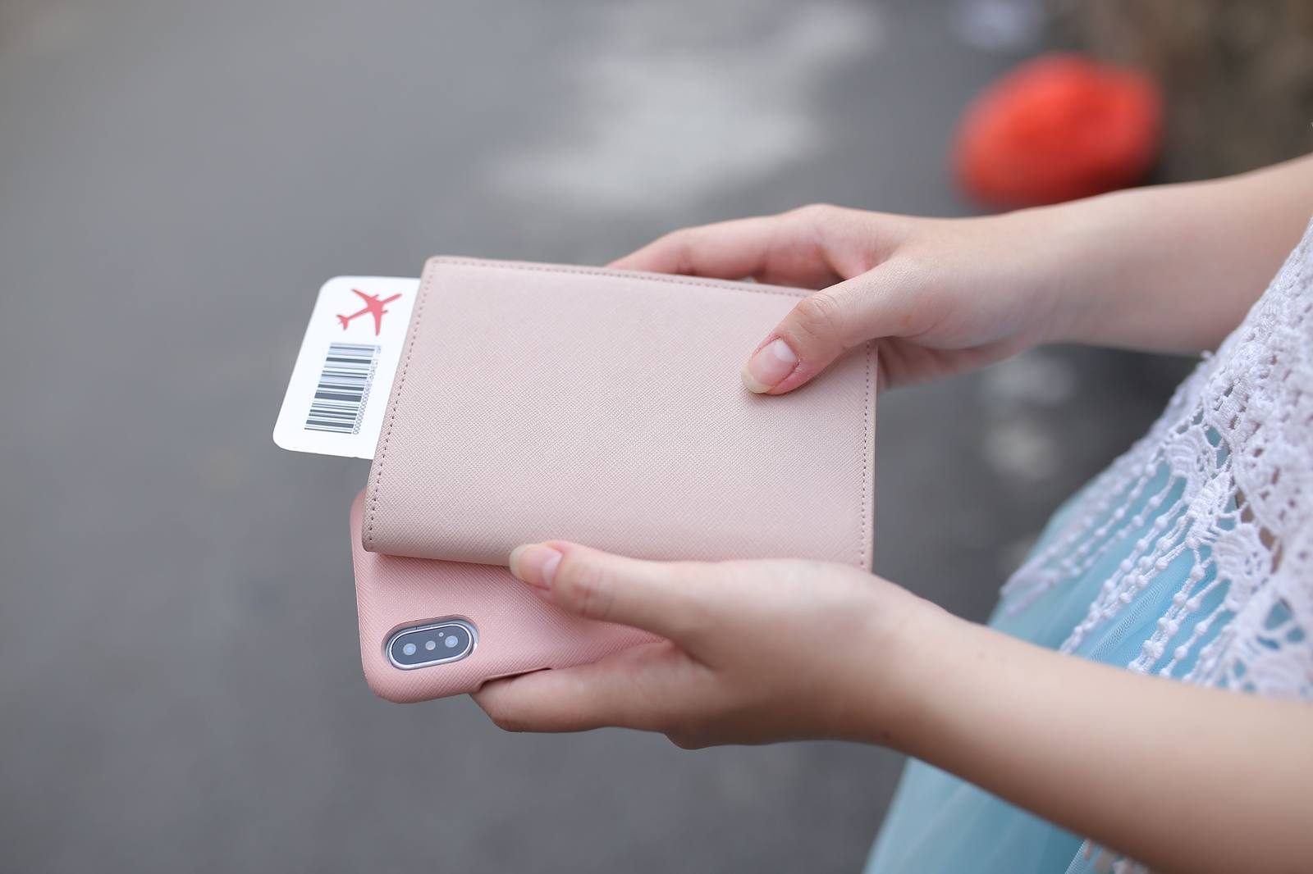
OFFLINE BACKUP
08 / 14
Plan for a lost or flat phone
Phones are vital for managing certain conditions including type 1, have a back up plan! Keep the information you need on two devices, and on paper.
Cheap Backup phone set up and charged
Documents stored on both phones
Family phone numbers on paper
Useful tips:
Do not rely on one phone for every medical record
Keep recovery codes securely offline
Save the local emergency number before arrival
IF EVERY DEVICE DIES
Your paper card should list family numbers, insurer and local emergency services.
If every device dies, paper still works.
THE ULTIMATE TYPE 1 TRAVEL PACKING LIST
12
Notes:
Reference: TravelHealthPro — First aid kits: https://travelhealthpro.org.uk/factsheet/74/first-aid-kits
Photograph: Thiếu Quân Võ Vũ via Pexels — https://www.pexels.com/photo/person-holding-pink-smartphone-and-wallet-5147224/

Slide 9

STOMACH ILLNESS
09 / 14
Prepare for illness
Dehydration can make glucose and ketones harder to manage, so pack the response in advance.
PACK
Oral rehydration/electrolytes
Loperamide (Imodium), if suitable
Probiotics, if in your routine
Digital thermometer
Senakok (helps loosen stools)
TYPE 1 SICK-DAY KIT
Ketone meter and in-date strips
Written sick-day plan
Soap and hand sanitizer
Small first aid kit
Blister plasters
CHECK FIRST
Look after your feet! Check for cuts and bruises etc regularly.
Never skip insulin. Seek urgent advice for persistent vomiting, inability to keep fluids down, or high or rising ketones. Always consult with a healthcare professional if necessary.
THE ULTIMATE TYPE 1 TRAVEL PACKING LIST
14
Notes:
Sources: TravelHealthPro — Travellers’ diarrhoea: https://travelhealthpro.org.uk/factsheet/53/travellers-diarrhoea
NHS — Loperamide: https://www.nhs.uk/medicines/loperamide/who-can-and-cannot-take-loperamide/
Diabetes UK — Type 1 sick-day guidance: https://www.diabetes.org.uk/sites/default/files/2021-03/A5_T1Illness_TREND_FINAL_1.pdf
Probiotics are listed only as an optional established routine; no prevention or treatment claim is made.
Photograph: Pavel Danilyuk via Pexels — https://www.pexels.com/photo/glass-of-water-and-medication-on-white-surface-6753139/

Slide 10
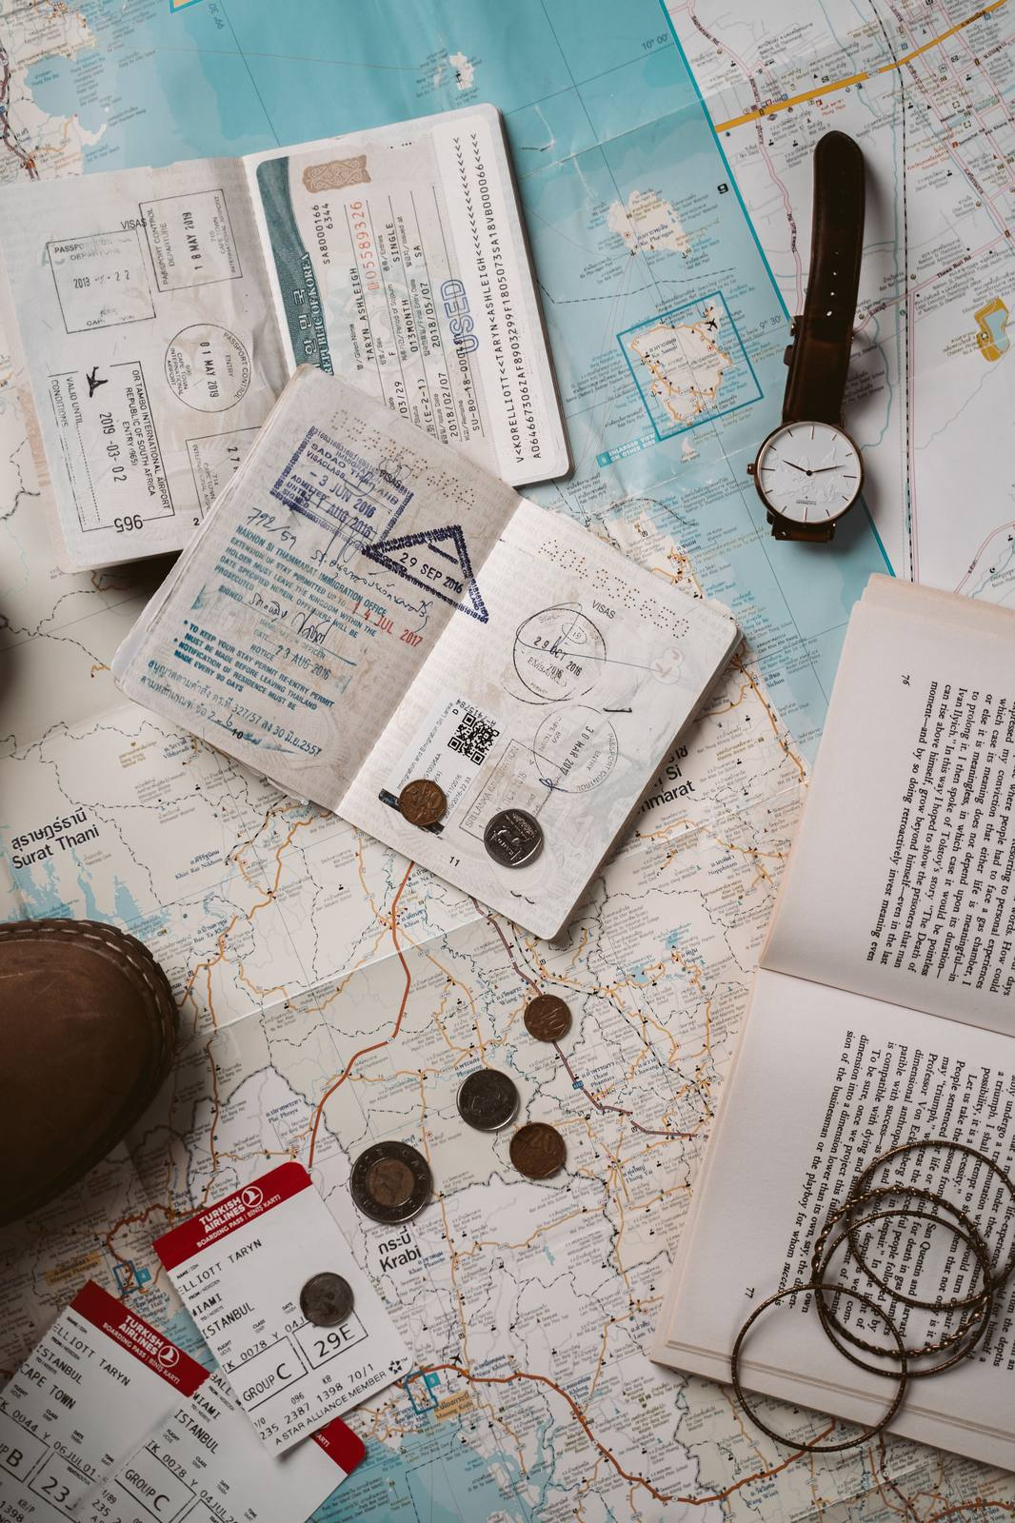
DOCUMENTS & DESTINATION
10 / 14
Documents and Security
Keep proof, some money and contacts offline.
Passport
Local emergency number
Travel insurance policy x 2
Insect spray
Doctor’s travel letter x 2
Medication/device list
Prescription copies
Diabetes and allergy plans
GHIC/EHIC, where relevant
Small combination padlocks
Family phone numbers
Never keep every card and document together
MY TIP
Pack two bank cards and print documents twice and separate when packing. Never keep every card and document together
THE ULTIMATE TYPE 1 TRAVEL PACKING LIST
17
Notes:
Sources: Diabetes UK travel guidance and TravelHealthPro destination guidance.
Photograph: Taryn Elliott via Pexels — https://www.pexels.com/photo/travel-documents-and-necessities-5405596/

Slide 11
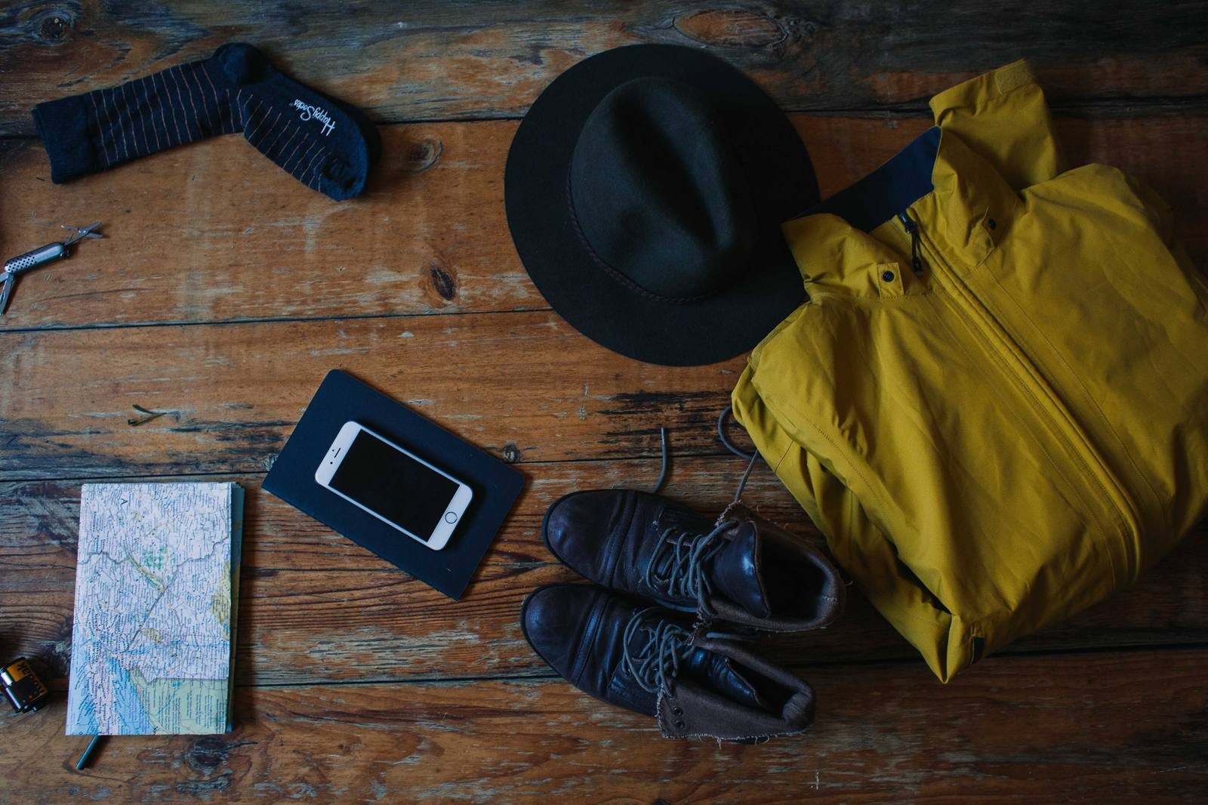
CLOTHES & PERSONAL KIT
11 / 14
Pack clothes and personal kit
Pack for the climate, protect your feet and keep one complete outfit in cabin baggage.
Breathable tops
Sunscreen and SPF lip balm
Trousers or shorts
Repellent and after-bite
Underwear
Toothbrush, paste, deodorant
Extra socks
Soap, sanitiser and wipes
Sleepwear
Plasters and blister dressings
Warm mid-layer
Tape and antiseptic
Waterproof jacket
Pain relief
Worn-in walking shoes
Sunglasses
Swimwear
Quick-dry towel
MY TIP
Take footwear you have already worn in. Divide packing cubes by use, not at random, and adjust layers for the forecast.
CABIN BACKUP: keep one full change of clothes with your day pack
THE ULTIMATE TYPE 1 TRAVEL PACKING LIST
15
Notes:
Reference: TravelHealthPro — First aid kits: https://travelhealthpro.org.uk/factsheet/74/first-aid-kits
Photograph: Rachel Claire via Pexels — https://www.pexels.com/photo/flatlay-of-traveler-clothes-and-essentials-5531437/

Slide 12
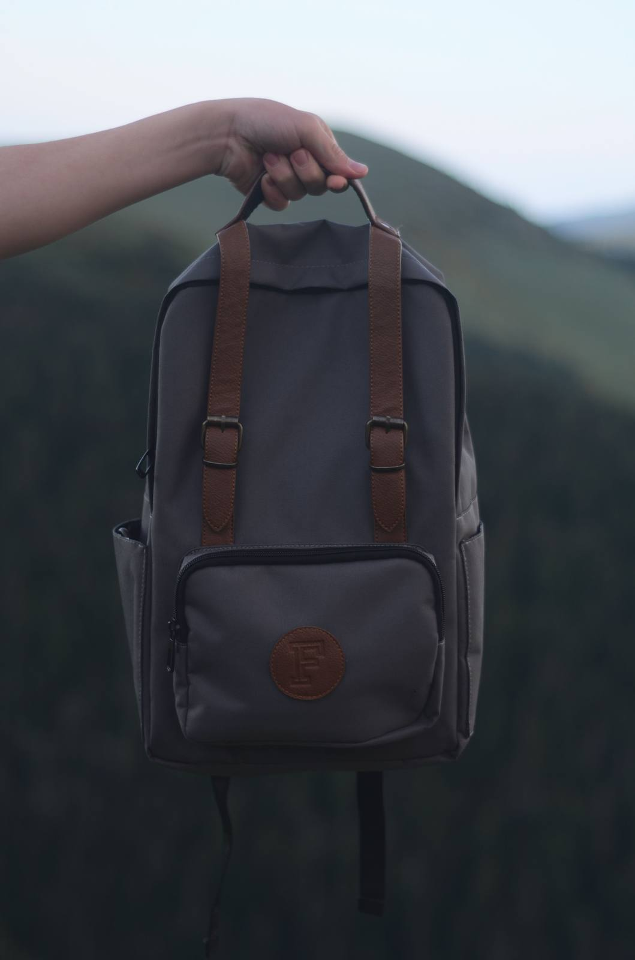
DAY PACK
12/ 14
How to Pack the 20 L day pack
This is the bag that stays beside you and covers the next 24 hours.
IMMEDIATE MEDICAL
Dedicated hypo pouch
Two auto-injectors
Daily insulin or pump kit
Glucose meter, CGM and ketone kit
TRAVEL SUPPORT
One day of regular medicines
Safe snack or backup meal
Water bottle and electrolytes
Documents and paper contacts
ONE FIXED PLACE
Backup phone + power bank
Keep urgent items in the same outer pocket so another person can find them fast.
Light layer or packable raincoat
Life-critical kit never goes in the main backpack or an overhead locker—keep the day pack within reach.
THE ULTIMATE TYPE 1 TRAVEL PACKING LIST
9
Notes:
Practical packing system based on the author’s travel experience and Diabetes UK travel guidance.
Photograph: Gül Işık via Pexels — https://www.pexels.com/photo/photo-of-person-carrying-backpack-2452345/

Slide 13
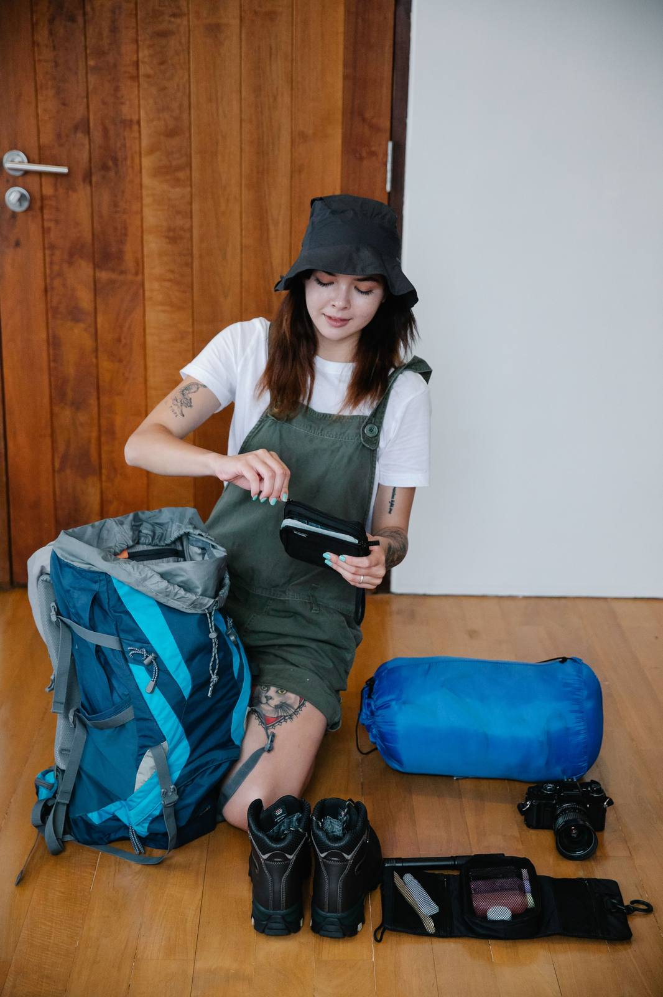
MAIN BACKPACK
13 / 14
How to Pack the 40–55 L backpack
Use it for replaceable, non-urgent items—not the kit that keeps you safe.
40–55 L backpack and rain cover
Packing cubes for clothes
Toiletries and laundry bag
Non-essential backup supplies
Remember:
Do not put insulin or essential medicines here if it is checked in
Do not bury hypo treatment or auto-injectors here
Do not keep every card, document or key together
WHAT BELONGS HERE
Clothes, spare footwear, toiletries, laundry items and replaceable equipment. Use labelled cubes so the bag can be packed and searched quickly.
Bulk belongs here; essential medicines do not.
THE ULTIMATE TYPE 1 TRAVEL PACKING LIST
8
Notes:
Practical packing system based on the author’s travel experience.
Photograph: Timur Weber via Pexels — https://www.pexels.com/photo/a-woman-preparing-to-travel-packing-her-stuff-in-a-back-pack-9186036/

Slide 14

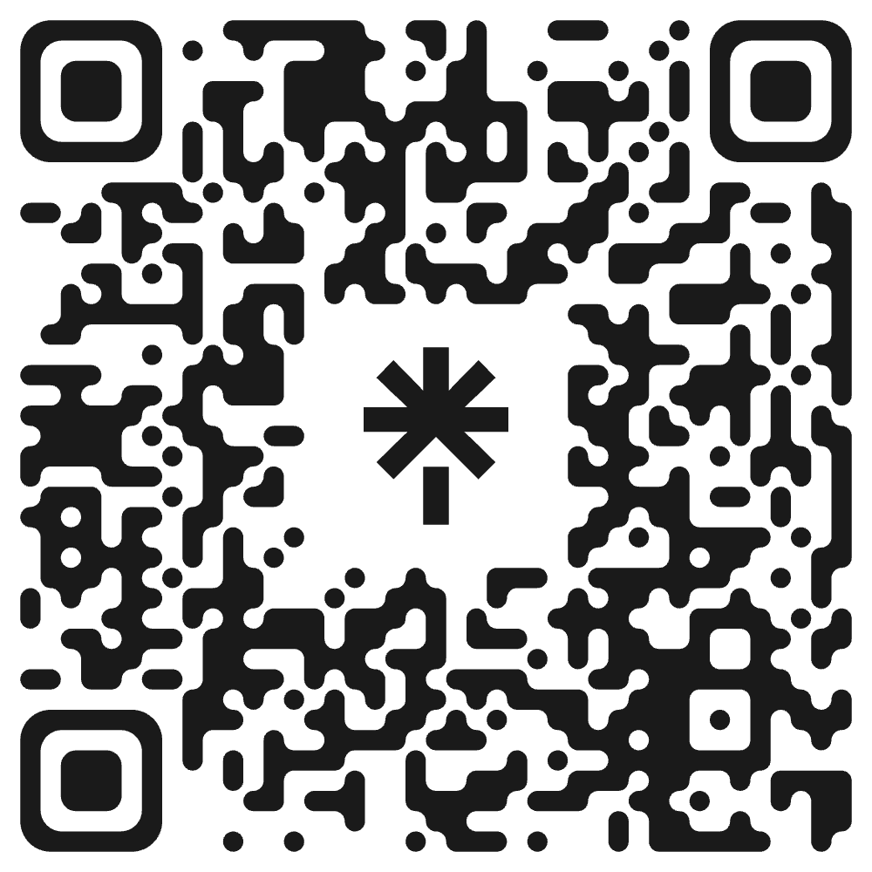
FINAL MASTER CHECK
14/ 14
Run the final double-check
Quantities and expiry dates checked
Both power banks fully charged
All essentials in cabin baggage
Backup phone and offline files ready
Hypo kit and auto-injectors accessible
Passport, insurance and contacts packed
Meters, sensors and chargers tested
Airline, customs and weather checked
Cooling and failure plans ready
Companion shown the emergency kits
A QUICK NOTE
This checklist reflects personal experience and UK travel-health guidance; it is not medical advice. Confirm your plan with your diabetes or allergy team, pharmacist, insurer and airline.
Guidance: NHS · Diabetes UK · TravelHealthPro · UK CAA · RCUK
Shop My Tried-and-Tested Type 1 Travel Gear
Everything I personally used across Southeast Asia.
Scan to see my full Amazon list:
THE ULTIMATE TYPE 1 TRAVEL PACKING LIST
18
Notes:
Visible disclaimer retained and rewritten in clear British English.
Guidance reviewed from NHS, Diabetes UK, TravelHealthPro, UK Civil Aviation Authority and Resuscitation Council UK.
Photograph: original photograph supplied by Ollie Steadman.

